Slide 1
Adaptive Rendering using Weighted Local Regression
Sung-Eui Yoon
KAIST

Slide 2
Acknowledgements
Collaborators
Bochang Moon; this is based on his thesis slides
My other students
Funding sources
Korea Research Foundation
Ministry of Knowledge Economy
Samsung
Microsoft Research Asia
Adobe
Boeing

Slide 3
Monte Carlo Ray Tracing
Produces photo-realistic rendering effects
Motion blur effects

Slide 4
Monte Carlo Ray Tracing
A large number of samples should be traced
N = 53
N = 64 K

Slide 5
Adaptive Rendering based on Weighted Local Regression
ACM Transaction on Graphics 2014
Will be presented on this Wed.
Notes:
I will only briefly talk about the adaptive rendering.

Slide 6
Bias-Variance Tradeoff
Image filtering
Gaussian filter: ${\hat{f}}_{h}\left(x\right)=\frac{1}{2πh^{2}}e^{−\frac{{|\left|x−x_{c}\right||}^{2}}{2h^{2}}}$
h: filtering bandwidth
Input noisy image
Notes:
In this work, we aim to compute visually pleasing results for MC generated images.
There can be different methods for the goal. In our case, we aim to design an image filtering tailed to MC rendering.
Suppose that we use a simple Gaussian filter on the image. It has a parameter, bandwidth parameter, $h$. Also, suppose that we have an image of black/white with random noise.

Slide 7
Bias-Variance Tradeoff
Image filtering
Gaussian filter: ${\hat{f}}_{h}\left(x\right)=\frac{1}{2πh^{2}}e^{−\frac{{|\left|x−x_{c}\right||}^{2}}{2h^{2}}}$
h: filtering bandwidth
Result with a small h = 0.3
High random error
i.e., high $var\left({\hat{f}}_{h}\left(x\right)\right)$
Low systematic error
i.e., low $bias\left({\hat{f}}_{h}\left(x\right)\right)$
Notes:
If we use a small bandwidth, say, 0.3, we fail to generate a smooth image, i.e., we have a high variance compared to its reference image containing black/white with the sharp edge.
Fortunately, we have a small bias on the edge with the small bandwidth. This means that we have a small bias error.

Slide 8
Bias-Variance Tradeoff
Image filtering
Gaussian filter: ${\hat{f}}_{h}\left(x\right)=\frac{1}{2πh^{2}}e^{−\frac{{|\left|x−x_{c}\right||}^{2}}{2h^{2}}}$
h: filtering bandwidth
Result with a large h = 5
Low random error
i.e., low $var\left({\hat{f}}_{h}\left(x\right)\right)$
High systematic error
i.e., high $bias\left({\hat{f}}_{h}\left(x\right)\right)$
Notes:
On the other hand, when we use a large bandwidth value, we get much smoother image, low variance.
Unfortunately, we get a high bias on the edge.

Slide 9
Our Approach
Local bandwidth selection (adaptive filtering)
In each pixel, we estimate the optimal bandwidth that minimizes the following:
$MSE\left({\hat{f}}_{h}\left(x\right)\right)={bias\left[{\hat{f}}_{h}\left(x\right)\right] }^{2}+var({\hat{f}}_{h}\left(x\right)$)
In smooth regions,
Large bandwidths are desirable for reducing variance.
In edge regions,
Small bandwidths are necessary for minimizing bias.
Notes:
The main problem is how to optimally choose bandwidths on different regions of the image.
Ideally, we want to set high bandwidth on smooth regions, while setting smaller bandwidth on edge regions.

Slide 10
Our Approach
Local bandwidth selection (adaptive filtering)
In each pixel, we estimate the optimal bandwidth that minimizes the following:
$MSE\left({\hat{f}}_{h}\left(x\right)\right)={E\left[{\hat{f}}_{h}\left(x\right)−f\left(x\right)\right] }^{2}+var({\hat{f}}_{h}\left(x\right)$)
Noisy image
Our bandwidth map
Our result
Notes:
Especially, we estimate the MSE for each pixel without relying upon the reference image, and compute our bandwidth map, as shown in the slide; white values in the map indicates large bandwidth values.

Slide 11
Our Approach
Local bandwidth selection (adaptive filtering)
$MSE\left({\hat{f}}_{h}\left(x\right)\right)={E\left[{\hat{f}}_{h}\left(x\right)−f\left(x\right)\right] }^{2}+var({\hat{f}}_{h}\left(x\right)$)
Local sample allocation (adaptive sampling)
Allocate more rays on pixels with high MSEs
Our result
Notes:
We then allocate more samples on regions with high MSE values.

Slide 12
Contributions
Apply a weighted local regression in a high dimensional feature space
Propose an automatic bandwidth selection to leverage different types of features

Slide 13
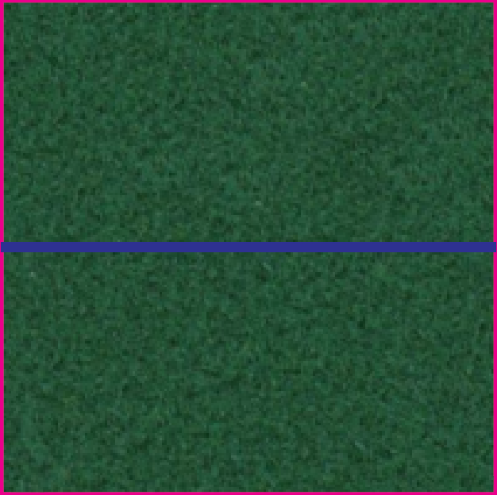
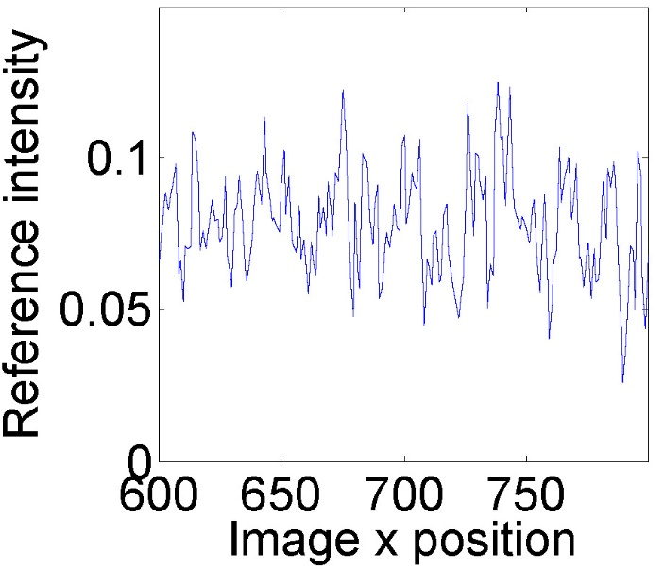
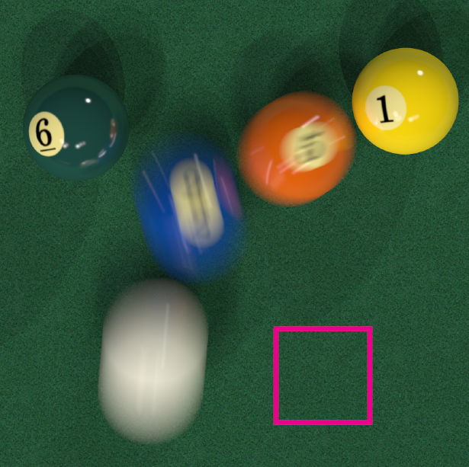
Contributions
Apply a weighted local regression in a high dimensional feature space
Notes:
Our first observation is that image values look very noise according to image space, as a low dimensional feature space.

Slide 14
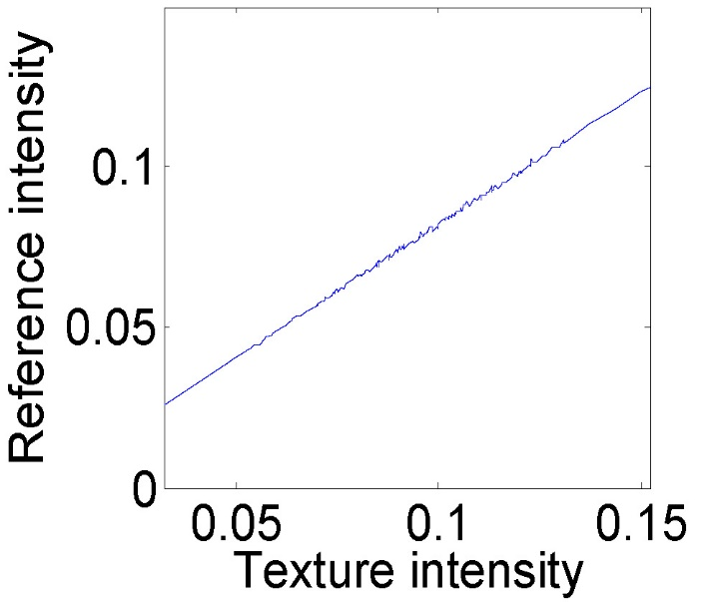
Contributions
Apply a weighted local regression in a high dimensional feature space
Notes:
But, when we use a higher dimensional feature space, in this case, one including the texture intensity, the output value linearly dependent on the texture feature.

Slide 15
Contributions
Apply a weighted local regression in a high dimensional feature space
Our formulation based on local regression [Cleveland 1979] $\left[\hat{a},\hat{b}\right]=\min_{α,β}{\sum_{i=1}^{n}{{\left[y^{i}−\left(α+β^{T}\left(x^{i}−x^{c}\right)\right)\right]}^{2}}K(\frac{dist\left(x^{i},x^{c}\right)}{hb_{j}})}$
$α, β^{T}$: coeff. of a linear model
$x :feature vector such as normals, textures, and depths$
$hb_{j} :bandwidth for j^{th} feature$
Notes:
As a result, we use a high dimensional vector space, typically including image space, texture, normal, commonly available at the G-buffer.
We then assume a linear regression function whose coefficient are alpha and beta.
The main question is how to optimally chose bandwidth parameters. In our formulation, we especially chose two terms, h and b_j, their products hb_j is the bandwidth for j th feature element.

Slide 16
Contributions
Apply a weighted local regression in a high dimensional feature space
Our formulation based on local regression [Cleveland 1979] $\left[\hat{a},\hat{b}\right]=\min_{α,β}{\sum_{i=1}^{n}{{\left[y^{i}−\left(α+β^{T}\left(x^{i}−x^{c}\right)\right)\right]}^{2}}K(\frac{dist\left(x^{i},x^{c}\right)}{hb_{j}})}$
$$y$$
${(x}^{i}$, $y^{i})$
$$x^{c}$$
$$x^{c}$$
$$x$$
Notes:
Visually speaking, we try to fit a line on MC samples.

Slide 17
Contributions
Apply a weighted local regression in a high dimensional feature space
Our formulation based on local regression [Cleveland 1979] $\left[\hat{a},\hat{b}\right]=\min_{α,β}{\sum_{i=1}^{n}{{\left[y^{i}−\left(α+β^{T}\left(x^{i}−x^{c}\right)\right)\right]}^{2}}K(\frac{dist\left(x^{i},x^{c}\right)}{hb_{j}})}$
$$y$$
$$x^{c}$$
$$x^{c}$$
$$x$$

Slide 18
Contributions
Apply a weighted local regression in a high dimensional feature space
Our formulation based on local regression [Cleveland 1979] $\left[\hat{a},\hat{b}\right]=\min_{α,β}{\sum_{i=1}^{n}{{\left[y^{i}−\left(α+β^{T}\left(x^{i}−x^{c}\right)\right)\right]}^{2}}K(\frac{dist\left(x^{i},x^{c}\right)}{hb_{j}})}$
$$y$$
$$x^{c}$$
$$x^{c}$$
$$x$$

Slide 19
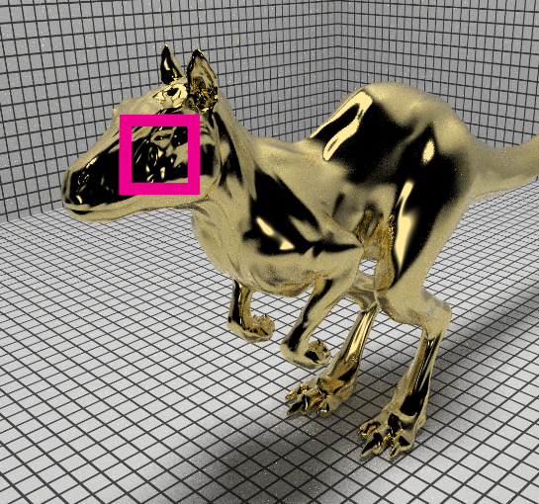
Contributions
Apply a weighted local regression in a high dimensional feature space
Input, N = 32
Killeroo model courtesy of headus 3D

Slide 20
Contributions
Apply a weighted local regression in a high dimensional feature space
$$K(\frac{dist\left(x^{i},x^{c}\right)}{hb_{j}})$$
$$K(\frac{dist\left(x^{i},x^{c}\right)}{hb_{j}})$$
MC Input
32 spp
Linear Approx.
rMSE 0.50889
[Bauszat et al. 11]
Ours
rMSE 0.00176
Reference
16K spp
Notes:
These are filtered images w/ and w/o considering bandwidth parameters.

Slide 21
Contributions
Propose an automatic bandwidth selection to leverage different types of features
Design a new optimal bandwidth selection based on the asymptotic expression [Ruppert 1994]
$bias\left({\hat{f}}_{hb}\left(x\right)\right)∝0.5h^{2}trace\left(BH{\hat{f}}_{hb}\left(x\right)\right)$ (H: Hessian)
$var\left({\hat{f}}_{hb}\left(x\right)\right)∝\frac{1}{n\left(x\right)h^{k}\prod_{j=1}^{k}{b_{j}} }$
$$\left[\hat{a},\hat{b}\right]=\min_{α,β}{\sum_{i=1}^{n}{{\left[y^{i}−\left(α+β^{T}\left(x^{i}−x^{c}\right)\right)\right]}^{2}}K(\frac{dist\left(x^{i},x^{c}\right)}{hb_{j}})}$$
$$hb_{j} :bandwidth for j^{th} feature$$
Notes:
Our main theoretical contributions are on selecting bandwidth parameters minimizing the MSE values.
WE have found that bias and variance of our linear regression model has useful asymtotpic relationship.
Please refer to the paper for more details.

Slide 22
Contributions
Propose an automatic bandwidth selection to leverage different types of features
$bias\left({\hat{f}}_{hb}\left(x\right)\right)∝0.5h^{2}trace\left(BH{\hat{f}}_{hb}\left(x\right)\right)$ (H: Hessian)
$$\left[\hat{a},\hat{b}\right]=\min_{α,β}{\sum_{i=1}^{n}{{\left[y^{i}−\left(α+β^{T}\left(x^{i}−x^{c}\right)\right)\right]}^{2}}K(\frac{dist\left(x^{i},x^{c}\right)}{hb_{j}})}$$
Noisy image
Est. derivatives along x
Our bandwidth along x
Notes:
Intuitively, the bias is related to the second derivative of unknown functions.
So, we set smaller bandwidth for higher second derivatives.

Slide 23
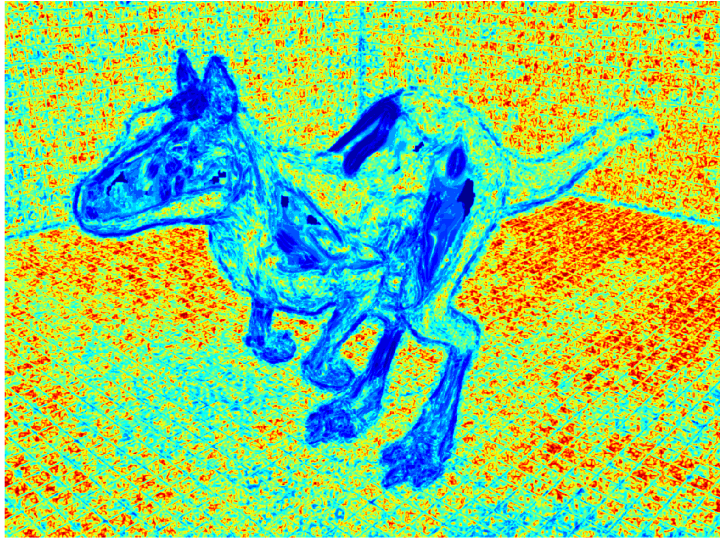
$$ban{dwidth}_{j}$$
MC Input
32 spp
$$ban{dwidth}_{1}≡h×b_{1}$$
Notes:
Given this MC Input image, this right image is a visualization result of bandwidths.

Slide 24
Estimation for Reconstruction Error
Reconstruction Result
SURE
[Li et al. 12]
Our Estimation
Reference Error
Notes:
Given our reconstruction result, we can estimate MSE. Our MSE estimation is very similar to the reference error, which cannot obtained in practice. To compute the reference error, we repeat our filtering on many input images (e.g., 1000 images).
Also, our estimation is more robust than the previous error estimation in terms of noise. Therefore, we can achieve more accurate bandwidth selection and optimal sampling map.
Q. How do we compute this reference error?

Slide 25
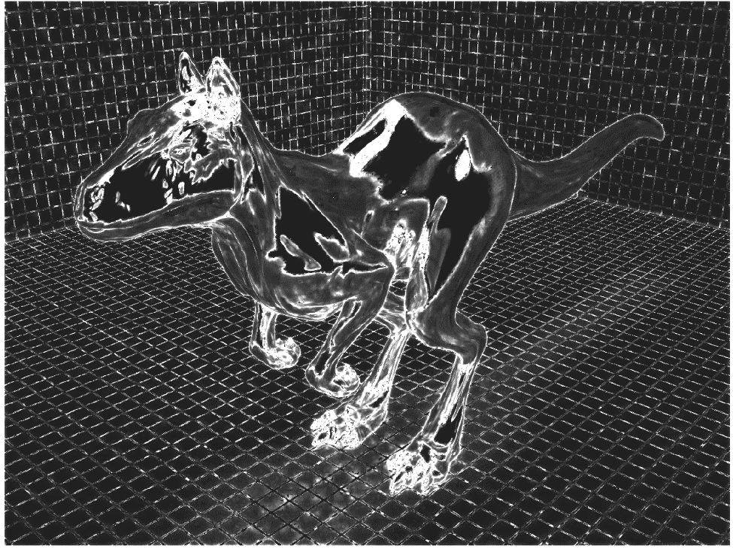
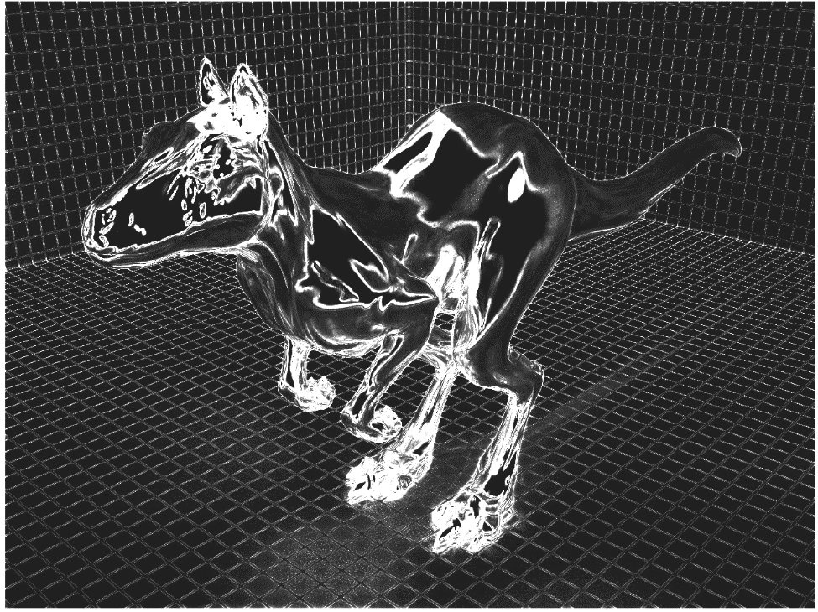
Adaptive Sampling
Our map using our error
(Correlation 0.78)
Reference map using reference error
Notes:
Given the estimated error, we know where we should allocate more samples to further reduce errors. In this example, we use higher sampling rates on the strong edge area where our reconstruction error is high. As you can see, our sampling map is quite close to the reference sampling map because of the accurate error estimation.

Slide 26
Results
San Miguel
Path tracing
Depth of field effects
Complex textured geometries

Slide 27
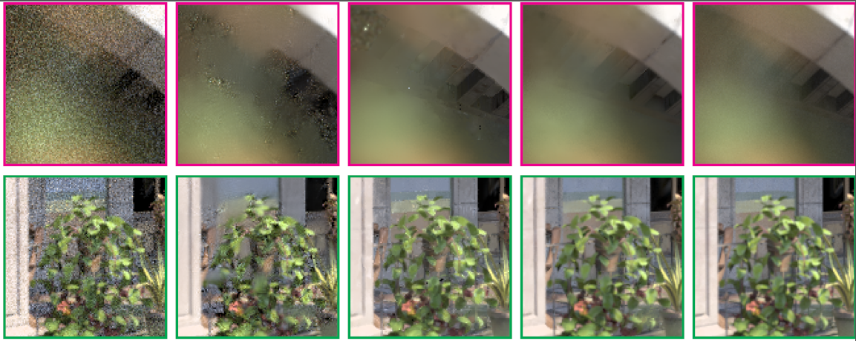
Equal-time Comparison
LD, N = 128
(665 s)
rMSE 0.06288
NLM, N = 115
(665 s)
rMSE 0.01242
SURE, N = 113
(665 s)
rMSE 0.01521
Ours, N = 115
(660 s)
rMSE 0.00448
Reference
N = 16K

Slide 28
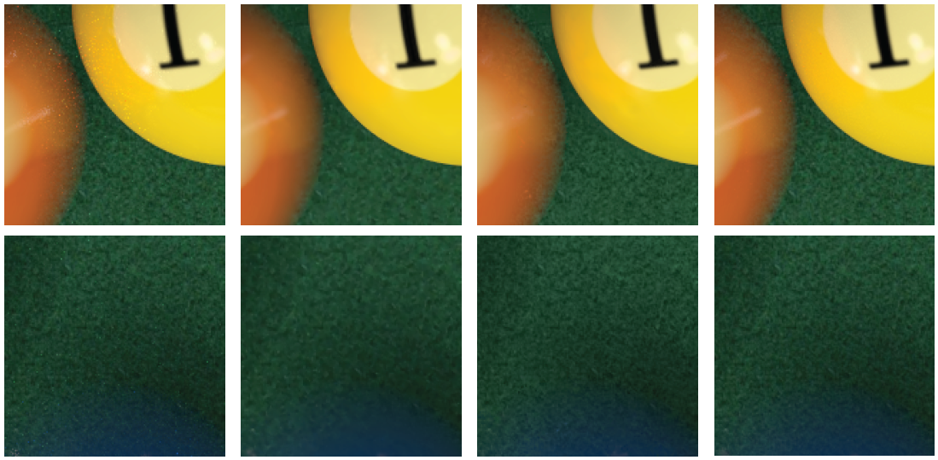
Equal-quality Comparison
NLM, N = 512
(1064 s)
rMSE 0.00047
SURE, N = 1K
(2202 s)
rMSE 0.00063
Ours, N = 32
(91 s)
rMSE 0.00044
Reference
N = 64K

Slide 29
Equal-time Comparison for Animation
MC 143 spp
Ours 128 spp
Notes:
Given the San Miguel scene, this video is an equal-time comparison between MC and our method. Our results shows a much reduced flickering.

Slide 30
Related Talks
Sampling & Filtering
Wednesday, 12 August 3:45 PM - 5:35 PM
Adaptive Rendering based on Weighted Local Regression
Adaptive Rendering with Linear Predictions

Slide 31
Linear Predictions
c
c: center pixel where we apply reconstruction
c
c
c
c
c
c
c
c
c
c
c
c
c
c
c
c
c
c
c
c
c
c
c
c
c
c
c
c
c
c
c
c
c
c
c
c
c
c
c
c
c
c
c
c
c
c
c
c
7 x 7 Input
Notes:
Given this equation, we may apply linear model based filtering at each pixel. C means center pixel where we apply reconstruction.
Unfortunately, this standard approach is very expensive because each reconstruction needs complex optimization.

Slide 32
Linear Predictions
$f\left(x_{i}\right)≈f\left(x_{c}\right)+∇f{\left(x_{c}\right)}^{T}\left(x_{i}−x_{c}\right)$
$$Ω_{c}^{P}(k)$$
c: center pixel
i
Estimate $f\left(x_{c}\right), ∇f{\left(x_{c}\right)}^{T}$ by least-squares in a prediction window $Ω_{c}^{P}(k)$
Predict all pixels’ color using $∇f{\left(x_{c}\right)}^{T}\left(x_{i}−x_{c}\right)$
c
7 x 7 Input
Unknown parameter!
Notes:
In our framework, we only apply the expensive reconstruction into a sparse number of center pixels, and we estimate center pixel’s color and its gradient by using a least-squares within a prediction window. Then, we predict all pixels’ color using gradients and the difference of features.
In this framework, there is one unknown parameter, prediction window size. So, we need to set this parameter.

Slide 33
Conclusion and Future Work
Proposed Weighted Local Regression (WLR) to reduce the required number of ray samples
Simple linear models work very well in a high-dimensional feature space
Robust error analysis is possible for weighted local regression
Future work
Support efficient multi-dimensional adaptive sampling
Test and optimize to other challenging rendering effects (e.g., subsurface scattering)
Codes/Scenes: http://sglab.kaist.ac.kr/WLR/

